Slide 1
Structure, Design, Extensibility and User Experience - Foundations for an Automation Framework
SOFTWARE QUALITY CONFERENCE
PACIFIC NW
ABHISHEK SHARMA
ARVIND SRINIVASA BABU
HEMANT PRASAD 08-OCT-2018
PNSQC ™

Slide 2
Agenda
The Challenges of Automating “LEGACY” code.
Foundation for an Automation Framework.
Design
Structure
Extensibility
User Experience
How to apply SDEU

Slide 3
Introduction
SOFTWARE QUALITY CONFERENCE
PACIFIC NW
Over several years, automation has taken center stage in the domain of Software Quality as it drives faster delivery with highest quality confidence.
Our team works on a native application that is deployed on tens of millions of machines worldwide. Frequent release commitments, new features and the agile process, stresses our need to increasingly speed up our validation process and our use of automation.
Over the course of the past decade, we developed couple of frameworks focused on features, services, or just simply automating our test suites. This worked well in the short-term but was unable to scale with our validation processes, which grew with every feature and release.
This Presentation will highlight some of our pitfalls and how we overcame them by structuring our automation suite, segregating design, test suites, and considering the user experience in adding new test cases and extending the framework itself.
PNSQC ™

Slide 4
What is automation ?
SOFTWARE QUALITY CONFERENCE
PACIFIC NW
Automation[1] is the task of repeatedly performing a set of actions without any manual intervention. Automated testing is the principle in which the validation of software modules is performed automatically as new code changes are introduced in the software.
1. Test Automation : https://en.wikipedia.org/wiki/Test_automation
PNSQC ™

Slide 5
The Challenges of Automating “LEGACY” code
SOFTWARE QUALITY CONFERENCE
PACIFIC NW
Tools
Automation Development
Design
Code Structure
Software Builds
Backwards compatibility
PNSQC ™

Slide 6
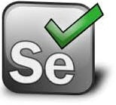
Tools
The Challenges of Automating “LEGACY” code
SOFTWARE QUALITY CONFERENCE
PACIFIC NW
PNSQC ™

Slide 7
Automation Development
Automated test code 5
Automated test code 10
Automated test code 15
Automated test code 20
Automated test code 4
Automated test code 9
Automated test code 14
Automated test code 19
Code Piece 5
Code Piece 10
Code Piece 15
Automated test code 3
Automated test code 8
Automated test code 13
Automated test code 18
Code Piece 4
Code Piece 9
Code Piece 14
Automated test code 2
Automated test code 7
Automated test code 12
Automated test code 17
Code Piece 3
Code Piece 8
Code Piece 13
Automated test code 1
Automated test code 6
Automated test code 11
Automated test code 16
Code Piece 2
Code Piece 7
Code Piece 12
Code Piece 6
Code Piece 11
The Challenges of Automating “LEGACY” code
SOFTWARE QUALITY CONFERENCE
Code Piece 1
PACIFIC NW
Automated test code 25
Automated test code 24
Automated test code 23
No proper process and maintenance, Automation code become non-reusable to more modern features and cannot support legacy features
Automated test code22
Automated test code 21
Automated test code 30
Automated test code 29
Automated test code 28
Automated test code 27
Automated test code
PNSQC ™

Slide 8
Design
The Challenges of Automating “LEGACY” code
Lack of design in Automation framework and short-term solutions may causes long term problems in maintaining the automation code.
Code Structure
Never combine framework code with test code.

Slide 9
Software Builds
The Challenges of Automating “LEGACY” code
Automation requires a formal build to get trigger, because of that automation results takes time.
Backward Compatibility
The automation framework without versioning results in breaking older version validations due to addition of new code to support new/modified features. For example:
Product 4.0.0 should be validated with Automation 4.0.0 : PASS
Product code 2.0.0 validation with Automation 4.0.0 : Fail

Slide 10
Foundation for an Automation Framework
SOFTWARE QUALITY CONFERENCE
PACIFIC NW
Design
Structure
Extensibility
User Experience
PNSQC ™

Slide 11
Design of an Automation Framework
SOFTWARE QUALITY CONFERENCE
PACIFIC NW
Modular design
Abstraction of test tools
Integration with CI tools ex. Teamcity
Capability to handle Test cases and Test scenarios
Easily expendable
Adoptability for new technologies/Languages
PNSQC ™

Slide 12
Structure of an Automation Framework (S)
SOFTWARE QUALITY CONFERENCE
PACIFIC NW
Never combine product test cases with framework code.
Apply versioning to your framework so that users know exactly which version of framework has what capabilities.
Define packages (if applicable) to organize your framework code. Monolithic framework requires high maintenance.
Maintain separate repository for your product test case automation code, if possible in the same branch as where the product development happens.
Identify product features and their interdependencies and model your product test cases to mirror the dependency matrix of the features.
PNSQC ™

Slide 13
Extensibility of an Automation Framework (E)
SOFTWARE QUALITY CONFERENCE
PACIFIC NW
A framework that is designed to be rigid will ultimately solve the short-term problem but will fail on the long-term.
Capability to add new features to framework.
Capability to add new product test cases.
Complex reporting mechanism on success and failures.
Adoptable for new tools, technologies and scripting languages.
Minimizing the effort of rewriting product test cases.
Easy to migrate or upgrade on new tools.
PNSQC ™

Slide 14
User Experience (U)
SOFTWARE QUALITY CONFERENCE
PACIFIC NW
User profiles will have different expectation when using the automation framework.
Automation Framework Developer
Test Case Automation Developer
Product Developer
PNSQC ™

Slide 15
SOFTWARE QUALITY CONFERENCE
Automation Framework Developer
PACIFIC NW
Primarily responsible to add or maintain the framework and provide integration and reporting mechanism for other types of users.
Ease of maintainability of framework codebase.
Ease of addition or removal of feature support.
Ease of addition or removal of external tools.
Abstraction of product test cases from framework codebase.
Versioned framework releases to track and maintain framework capabilities.
PNSQC ™

Slide 16
Test Case Automation Developer
SOFTWARE QUALITY CONFERENCE
PACIFIC NW
The predominant user of an Automation Framework would be the product’s test case automation developer.
Ease of integrating test cases into automation framework.
Platform agnostic way to acquire infrastructure resources to perform validation.
Ability to write automation code that is coherent with the manual test case execution workflow.
Framework that allows multiple technologies or architectures when automating different features.
PNSQC ™

Slide 17
Product Developer
SOFTWARE QUALITY CONFERENCE
PACIFIC NW
A good automation framework experience for a product developer would be
Faster results of unit tests.
Faster results of product feature validation.
Faster results of end-to-end testing.
PNSQC ™

Slide 18
Product Developer
SOFTWARE QUALITY CONFERENCE
PACIFIC NW
The product developer is primarily the initiator of new product features and their inputs might be essential in adding new framework features to support automation of test cases.
Faster results of unit tests.
Faster results of product feature validation.
Faster results of end-to-end testing.
PNSQC ™

Slide 19
How to apply SDEU philosophy to non-server technologies ?
SOFTWARE QUALITY CONFERENCE
PACIFIC NW
SDEU stands for Structure, Design Extensibility and User experience
PNSQC ™

Slide 20
SOFTWARE QUALITY CONFERENCE
Identify the structure of the framework
PACIFIC NW
Gather the infrastructure requirements to perform validation of your product.
Design the framework for reusability. Make components for your framework that can be re-used everywhere.
Identify your Continuous Integration (CI) pipeline and how to fit your automation to make Continuous Delivery (CD) of your product.
Define an integration mechanism to allow automation engineers to seamlessly automate their product.
PNSQC ™

Slide 21
SOFTWARE QUALITY CONFERENCE
Differentiate test cases from the framework itself
PACIFIC NW
Never combine the automation framework with product test cases. The framework needs to be agnostic of the product to maximize reusability.
A product test case will entirely focus on the product, whereas the framework would abstract the complexity of management of underlying tools.
Maintain versioning of the framework to facilitate addition of features and updating of tools as and when necessary.
PNSQC ™

Slide 22
SOFTWARE QUALITY CONFERENCE
Optimizing build process
PACIFIC NW
Sequential building process debug and release.
Resolve dependency on different components.
PNSQC ™

Slide 23
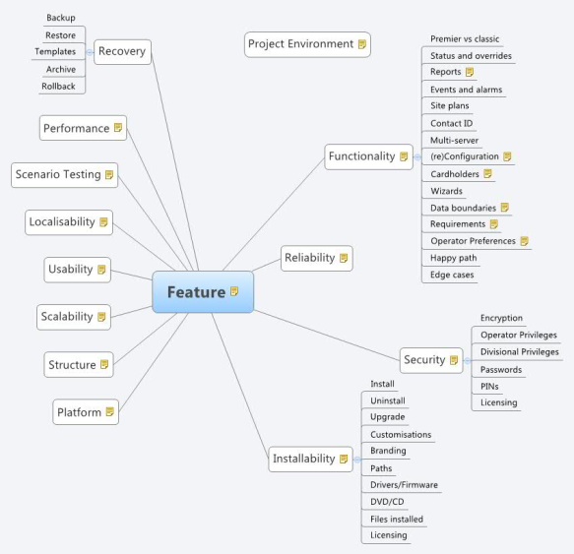
Segregating white box, grey box and black box testable code base

Slide 24
SOFTWARE QUALITY CONFERENCE
PACIFIC NW
Identify areas of code like utilities or helper modules that can be unit tested independently of the product’s core business logic.
The business logic should be gray box tested.
The end-to-end system verifications tests, or integration tests of our product from deployment to uninstallation falls under black box testing.
PNSQC ™

Slide 25
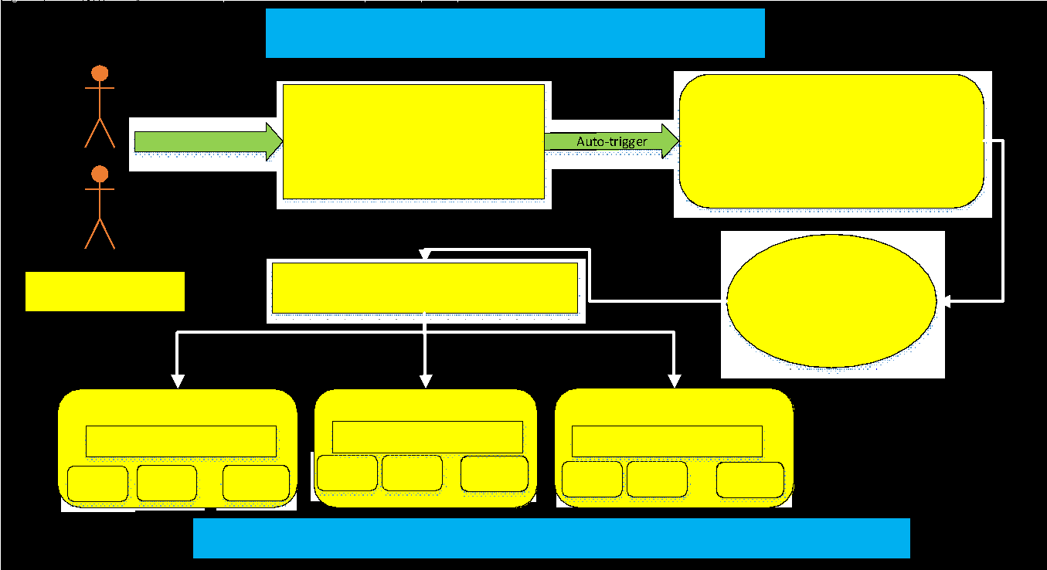
SOFTWARE QUALITY CONFERENCE
Keep Unit Tests simple
PACIFIC NW
PNSQC ™

Slide 26
SOFTWARE QUALITY CONFERENCE
Identify tools for grey box and black box testing
PACIFIC NW
A single tool or script might never solve automation efforts for all features. The design of our automation framework should be accommodating in including different tools and provide a seamless switch between different tools and help in configuring them.
PNSQC ™

Slide 27
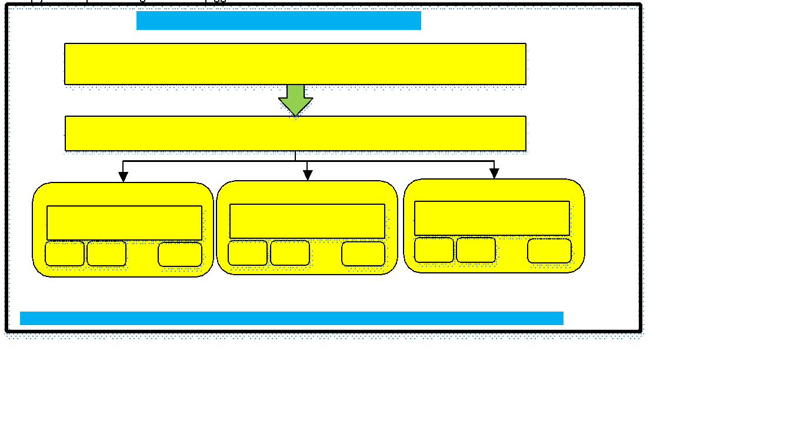
SOFTWARE QUALITY CONFERENCE
PACIFIC NW
Defining pipelines for components and features of the product
PNSQC ™

Slide 28
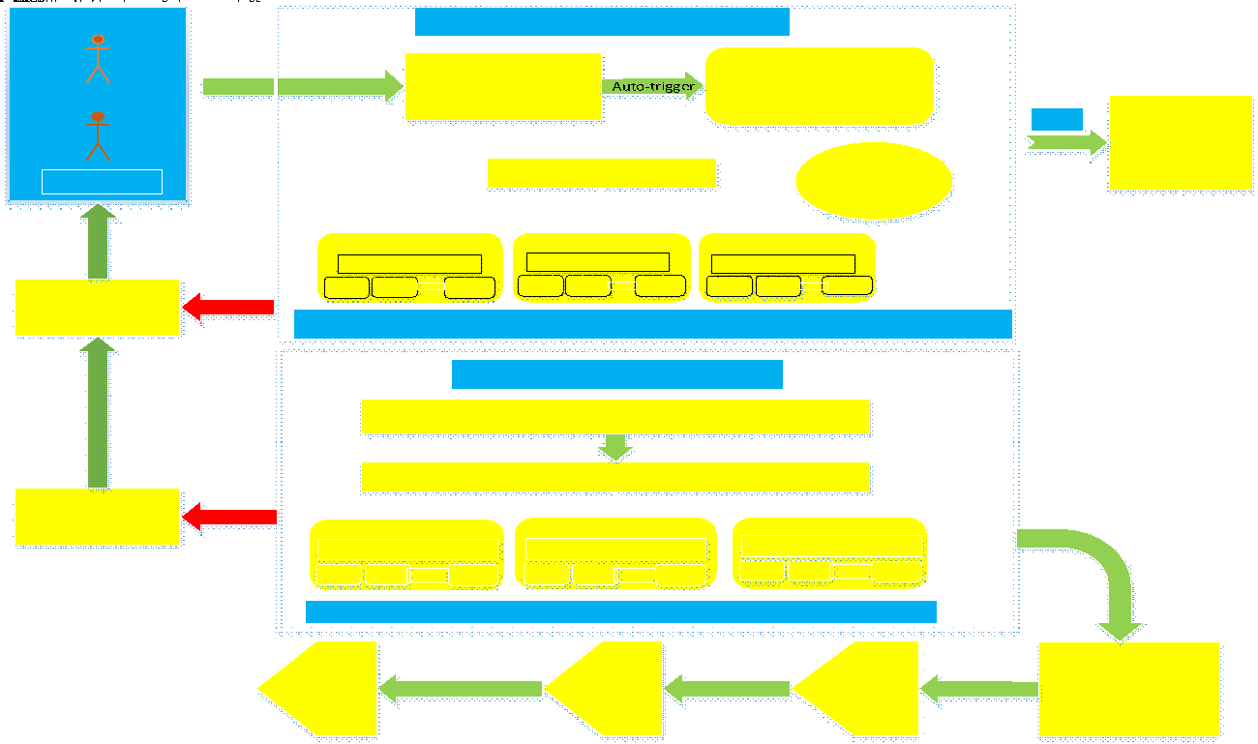
SOFTWARE QUALITY CONFERENCE
Defining end-to-end automation pipeline
PACIFIC NW
PNSQC ™

Slide 29
SOFTWARE QUALITY CONFERENCE
SDEU in non-server technologies
PACIFIC NW
Identify the structure of the framework
Differentiate test cases from the framework itself
Optimizing build process
Segregating white box, grey box and black box testable code base
Keep Unit Tests simple
Identify tools for grey box and black box testing
Defining pipelines for components and features of the product
Defining end-to-end automation pipeline
PNSQC ™

Slide 30
Reference
SOFTWARE QUALITY CONFERENCE
PACIFIC NW
Arvind Srinivasa Babu
linkedin.com/in/arvindsbabu
Abhishek Sharma
linkedin.com/in/abhishek-sharma-b2082711
PNSQC ™

